Slide 1

Mini-Project CS3PC04
To:
Prof. Jyotsana Goyal
By:
Aditya Raj Singh Tomar EN22CS301062
Akash Ghosh EN22CS301082
Akash Ravi Jaisinghani EN22CS301084
Of Batch B1

Slide 2

Implementation of Smart Vitality Tracker with AI

Slide 3
Technologies
Pandas : Pandas is used for handling data in .csv format as DataFrames.
NumPy : NumPy provides an array object of arbitrary homogeneous items, fast mathematical operations over arrays.
SkLearn : SkLearn is a Python module integrating classical machine learning algorithms in the tightly-knit world of scientific Python packages (numpy, scipy, matplotlib).
Metrics(mean_squared_error), Model selection(train_test_split), Pipeline(Pipeline, make_pipeline), Impute(SimpleImputer), Preprocessing (StandardScaler), Linear Model (LinearRegression).
Seaborn/MatPlotLib : Seaborn/MatPlotLib are libraries used for plotting of data.
PyQt5 : A package developed for easy UI designing and event handling connections (signals/slots).
SciPy : Fundamental algorithms for optimization, Extends NumPy, Provides Specialized data structures.
JobLib : Joblib enables multiprocessing across several machines or cores on a single machine, which enables programmers to parallelize jobs across numerous machines. Saves and Loads ML Models.

Slide 4
Code: Dataset Sample (Sleep Efficiency)
1 | ID | Age | Gender | Bedtime | Wakeup time | Sleep duration | Sleep efficiency | REM sleep percentage | Deep sleep percentage | Light sleep percentage | Awakenings | Caffeine consumption | Alcohol consumption | Smoking status | Exercise frequency
2 | 1 | 65 | Female | 2021-03-06 01:00:00 | 2021-03-06 07:00:00 | 6.0 | 0.88 | 18 | 70 | 10 | 0.0 | 0.0 | 0.0 | Yes | 3.0
3 | 2 | 69 | Male | 2021-12-05 02:00:00 | 2021-12-05 09:00:00 | 7.0 | 0.66 | 24 | 28 | 53 | 3.0 | 0.0 | 3.0 | Yes | 3.0
4 | 3 | 40 | Female | 2021-05-25 21:30:00 | 2021-05-25 05:30:00 | 8.0 | 0.89 | 20 | 70 | 10 | 1.0 | 0.0 | 0.0 | No | 3.0
5 | 4 | 40 | Female | 2021-11-03 02:30:00 | 2021-11-03 08:30:00 | 6.0 | 0.51 | 28 | 25 | 52 | 3.0 | 50.0 | 5.0 | Yes | 1.0
6 | 5 | 57 | Male | 2021-03-13 01:00:00 | 2021-03-13 09:00:00 | 8.0 | 0.76 | 27 | 55 | 18 | 3.0 | 0.0 | 3.0 | No | 3.0
7 | 6 | 36 | Female | 2021-07-01 21:00:00 | 2021-07-01 04:30:00 | 7.5 | 0.9 | 28 | 60 | 17 | 0.0 | Na | 0.0 | No | 1.0

Slide 5
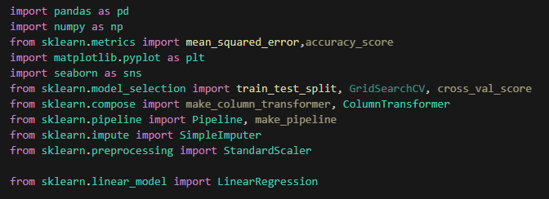
Code: Sleep Analysis Model (Overview)

Slide 6
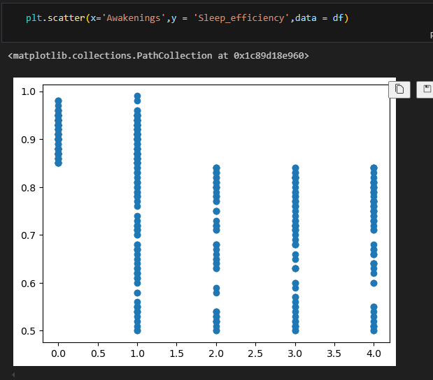
Code: Sleep Analysis Model (Overview)

Slide 7
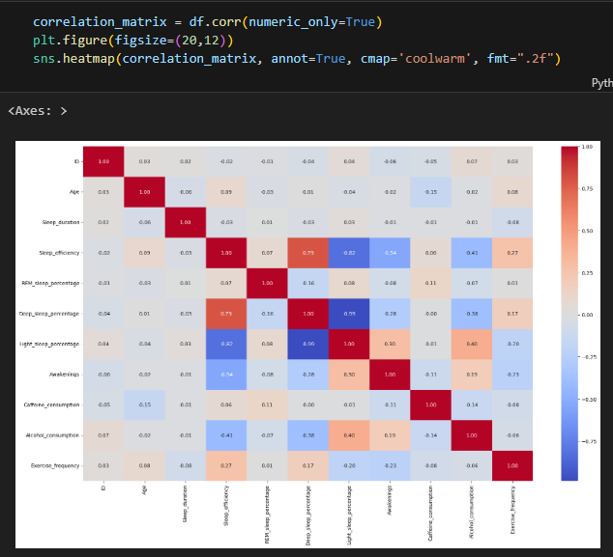
Code: Sleep Analysis Model (Overview)

Slide 8
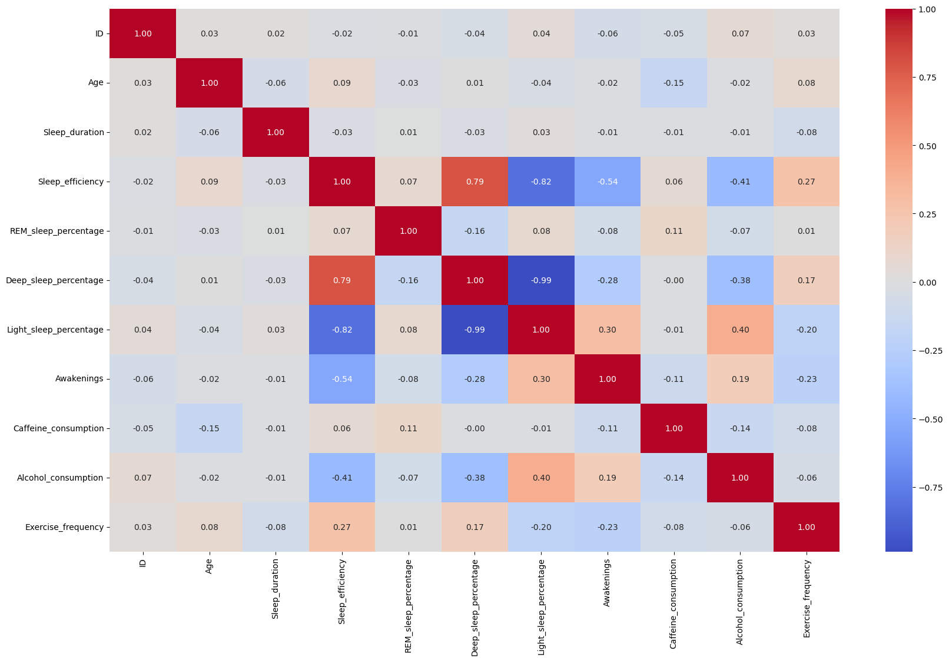
Code: Sleep Analysis Model (Overview)

Slide 9
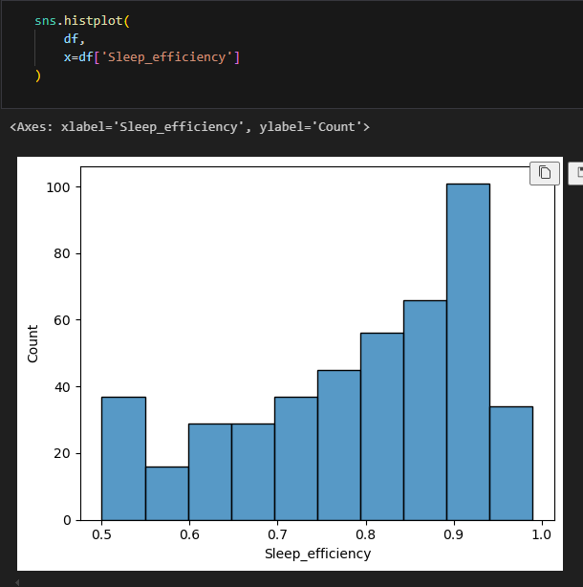
Code: Sleep Analysis Model (Overview)

Slide 10
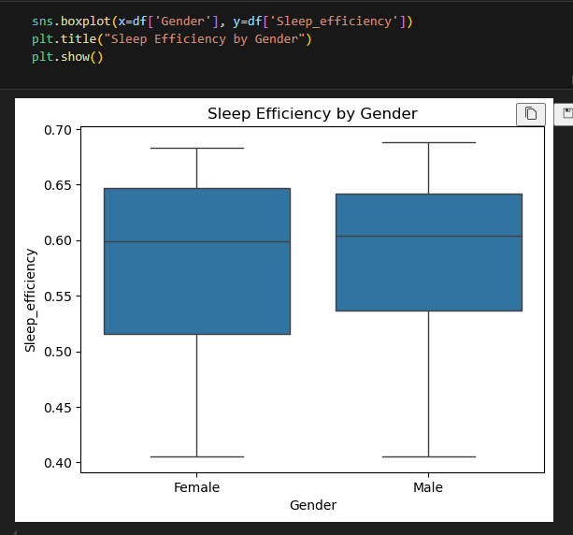
Code: Sleep Analysis Model (Overview)

Slide 11
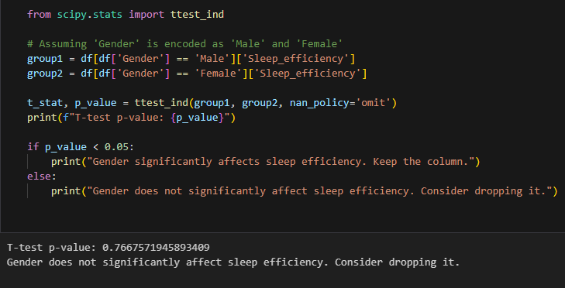
Code: Sleep Analysis Model (Overview)

Slide 12
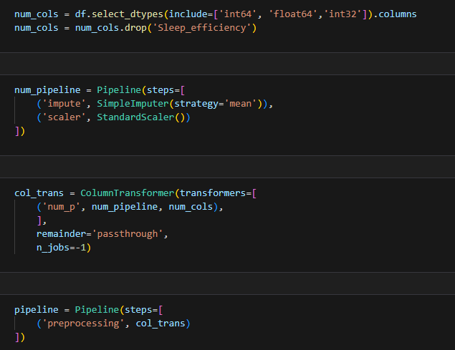
Code: Sleep Analysis Model (Overview)

Slide 13
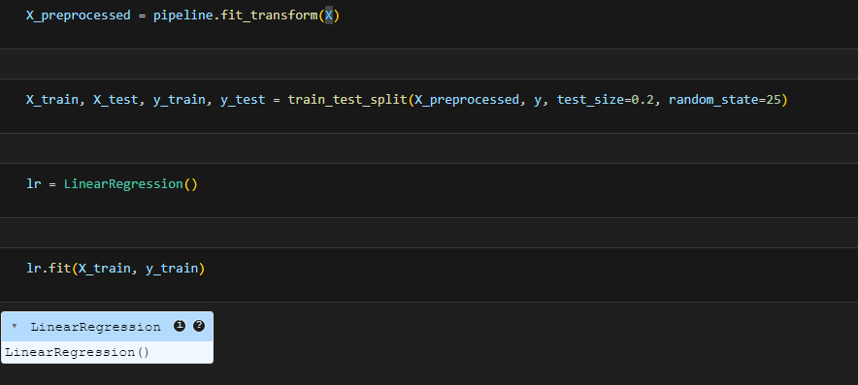
Code: Sleep Analysis Model (Overview)

Slide 14
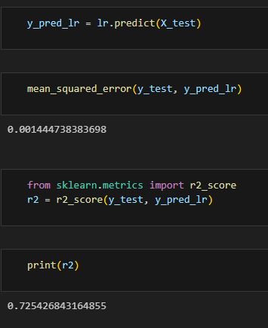
Code: Sleep Analysis Model (Overview)

Slide 15
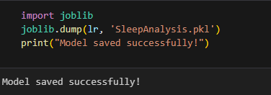
Code: Sleep Analysis Model (Overview)

Slide 16
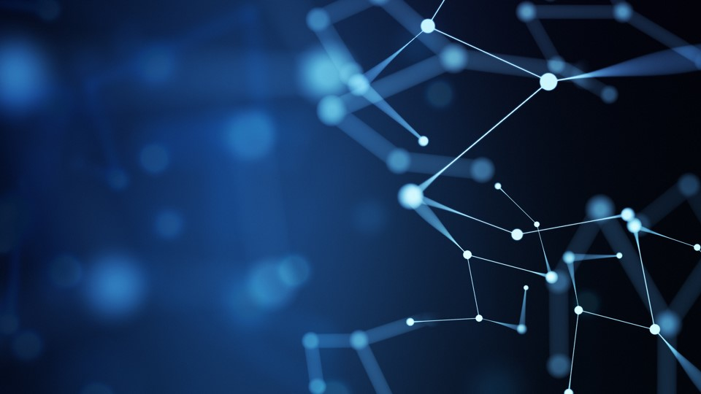
UI Design using PyQt5

Slide 17

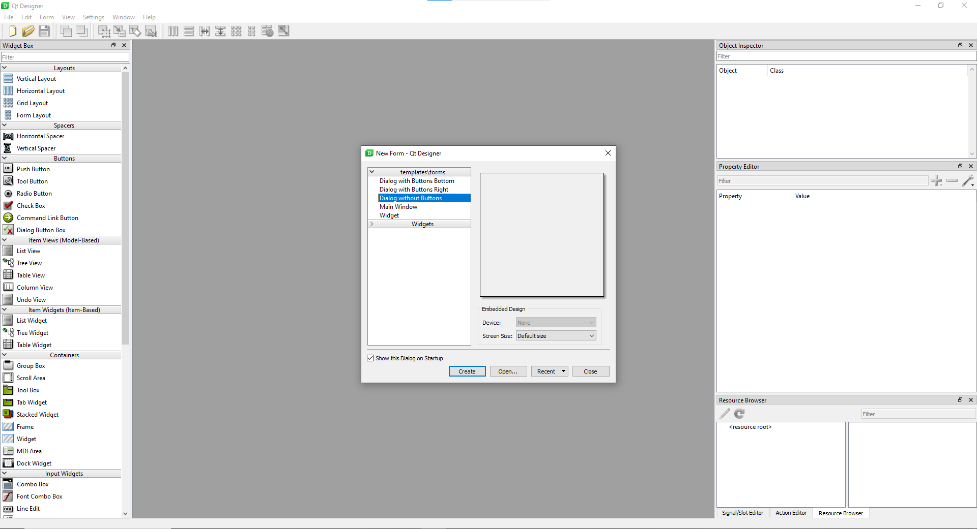
Code: UI Design by PyQt5 (Overview)

Slide 18
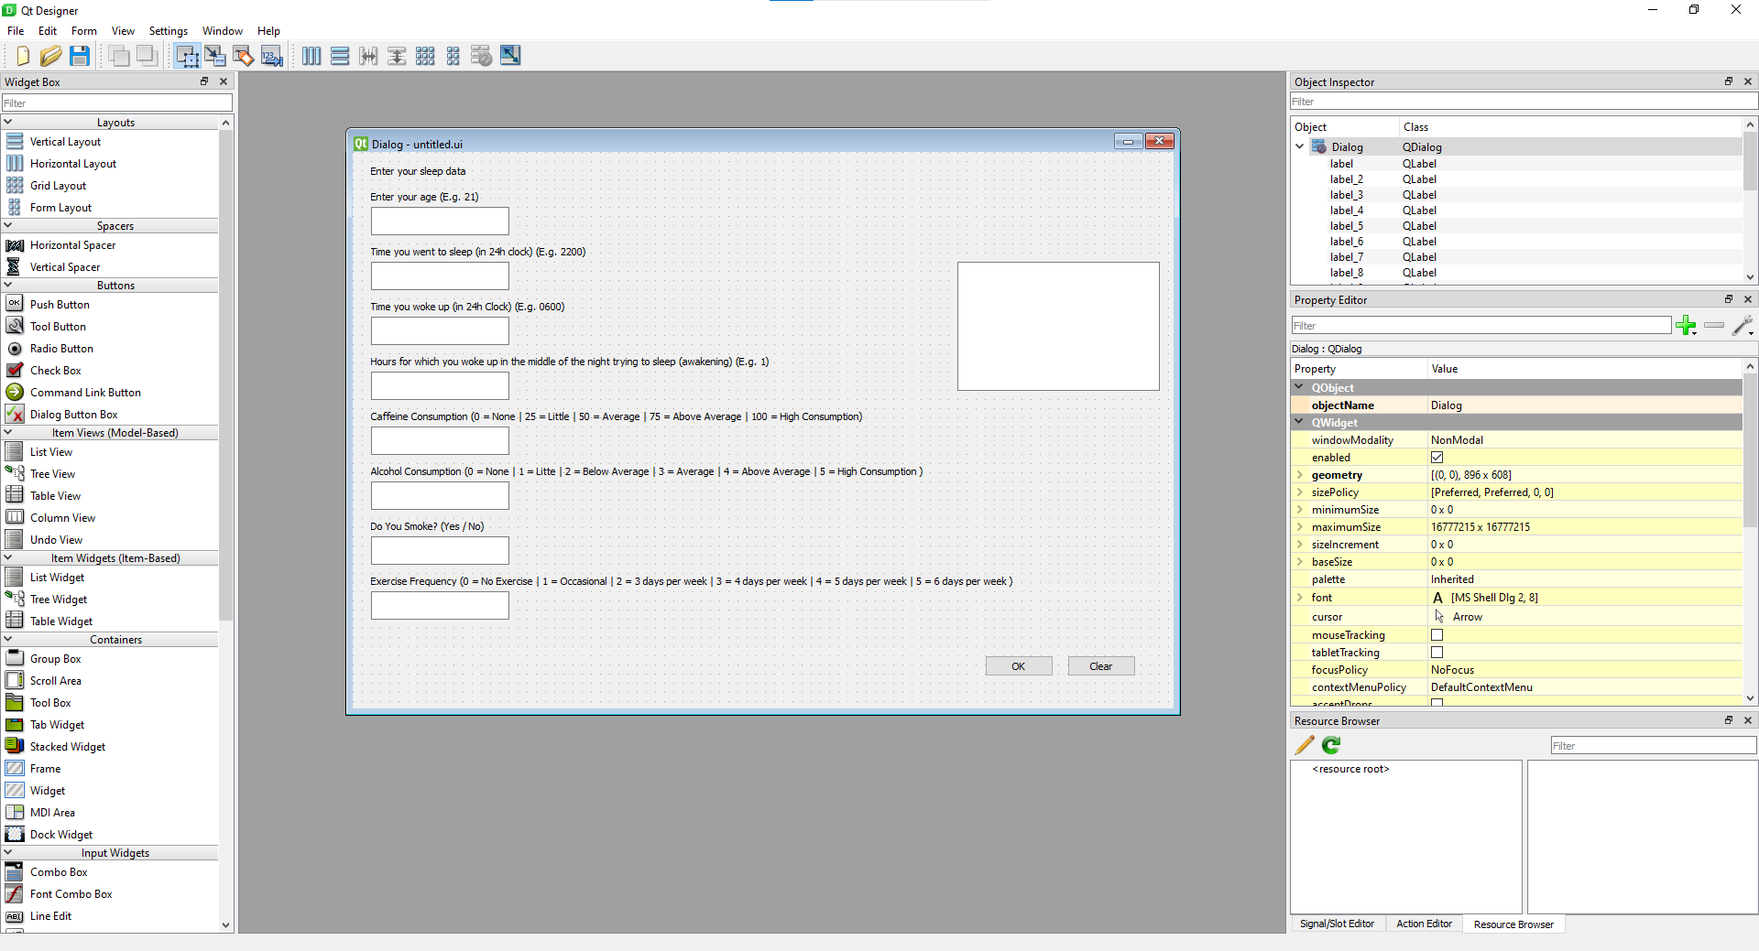
Code: UI Design by PyQt5 (Overview)

Slide 19
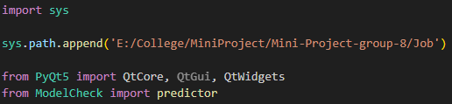
Code: UI Design by PyQt5 (Overview)

Slide 20
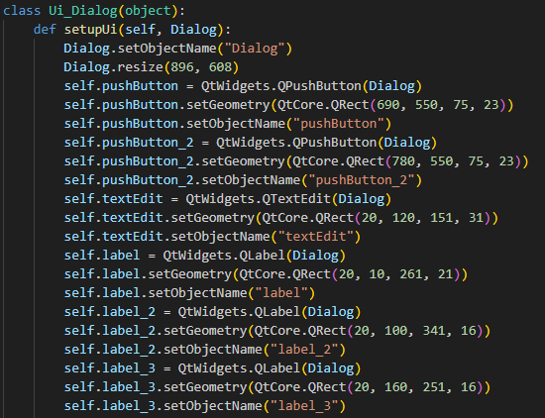
Code: UI Design by PyQt5 (Overview)

Slide 21
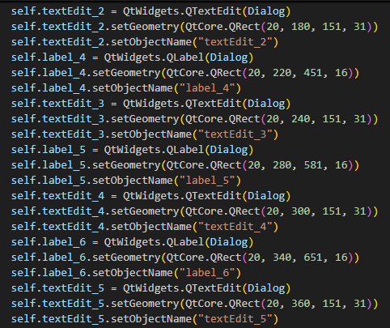
Code: UI Design by PyQt5 (Overview)

Slide 22
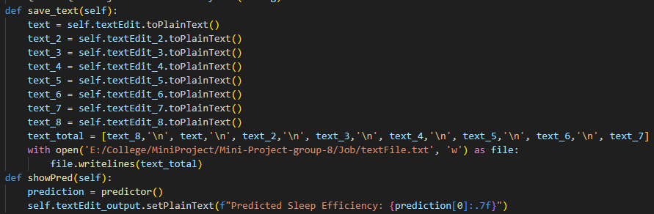
Code: UI Design by PyQt5 (Overview)

Slide 23
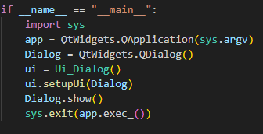
Code: UI Design by PyQt5 (Overview)

Slide 24
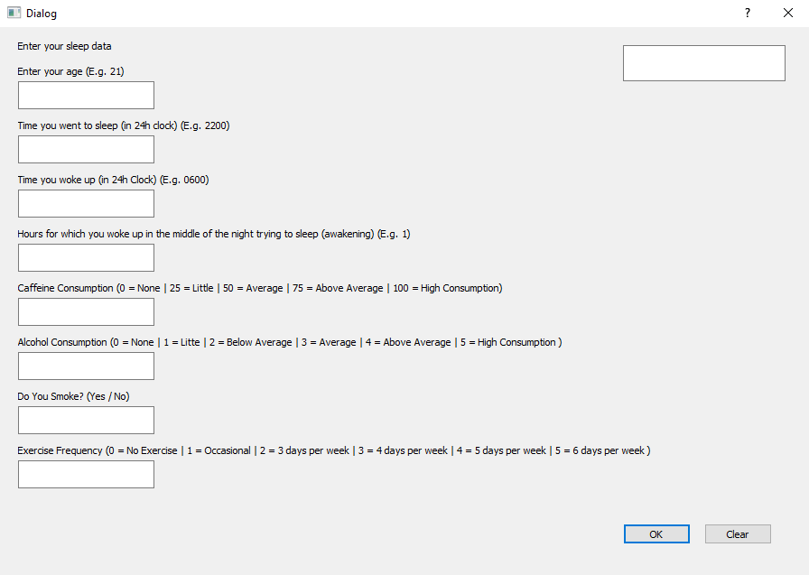
Execution of the Code

Slide 25
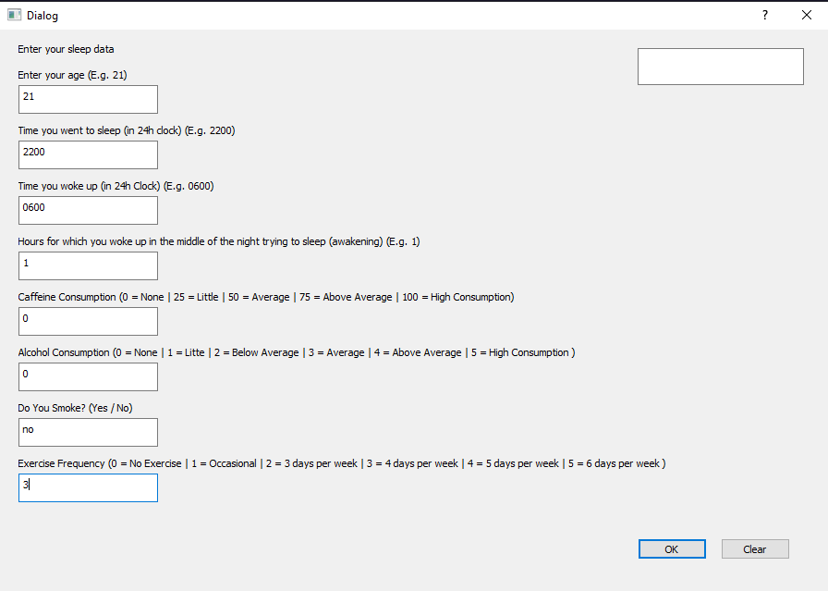
Execution of the Code

Slide 26
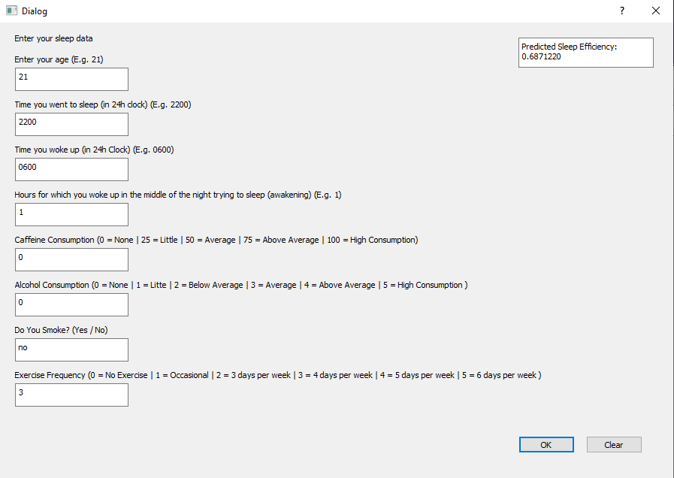
Execution of the Code

Slide 27
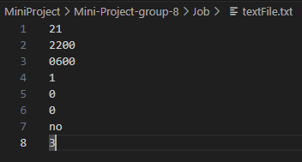
Execution of the Code

